Slide 1
Some Current SDLT Issues
Patrick Cannon
15 Old Square
clerks@15oldsquare.co.uk
www.patrickcannon.net
7 March 2019
© Patrick Cannon

Slide 2
Topics
Mixed use claims
Problems claiming MDR
Finance Act 2019 update and issues with the 3% higher rates
HMRC’s harsh tactics with legacy SDLT schemes
HMRC errors with enquiries and investigations
Non-UK resident surcharge consultation
© Patrick Cannon

Slide 3
Mixed use claims
High stakes - Table A v Table B – 15% v 5%
HMRC denying previous published guidance despite tax tribunal using it in Bewley [2019]
“Garden or grounds” includes all land sold with a dwelling?
“Agricultural” land can be residential?
Grazing licence terminated several days before completion and reinstated at completion can be ignored as intended future use
Several appeals working their way to the tax tribunal
© Patrick Cannon

Slide 4
Problems claiming MDR
Multiple Dwellings Relief introduced July 2011
Failure to spot the “granny annex” tax saving in 2012 – professional negligence?
What is a separate dwelling for MDR?
Internal door removed but flat has the means for independent living? What if granny has Alzheimer’s?
Relevance of council tax designation and other indicators?
© Patrick Cannon

Slide 5


FA 2019 update: What is a “major interest”?
Undivided equitable estate held by A and B as joint tenants or tenants in common
Legal title held by A and B as joint tenants on trust of land
Acacia Cottage
© Patrick Cannon

Slide 6
FA 2019 update: “Major interest” loophole
3% higher rates are charged on the purchase of an additional dwelling if individual buyer already owns a “major interest” in another dwelling
Pollen Estate v HMRC [2013]: the undivided shares of joint tenants are by themselves not “major interests”
HMRC August 2007 Technical News: “In addition, we would not wish to argue that an undivided share was a major interest.”
From 29 10 2018 new para 2(5) Sch 4ZA provides that “major interest” in a dwelling includes a share in a major interest in a dwelling
© Patrick Cannon

Slide 7
FA 2019 update: Main residence replacement time limits
New main residence acquired before sale of old main residence – initially pay the 3%
Refund of the 3% SDLT can be claimed if old main residence sold within 3 years
Refund claim must be made within 12 months of filing date for new acquisition or if later, 12 months from disposal of old main residence (extended from 3 months on 29 10 2018)
Time limits are strictly enforced
© Patrick Cannon

Slide 8
Purchase of two new main residence replacements to knock together?
Can you claim a refund of the 3% paid on each when you sell the old main residence within 3 years?
HMRC say no, you can only claim a refund on the first one
But if both dwellings are bought before sale of old main residence with intention of becoming buyer’s new main residence there seems to be no rule to prevent a refund
Only rule stopping double counting is where the old main residence is sold in the 3 years after the purchase of a new main residence (para 3(6)(b)) – the old main residence cannot then also be used against the subsequent purchase of another main residence as it can only count once: para 8(2)
© Patrick Cannon

Slide 9
What is a “dwelling”?
What counts as a dwelling? Para 18 (2)(a) Sch 4ZA
A building “used or suitable for use as a single dwelling”
Test applies at completion date, not historically or prospectively
Bewley Ltd v HMRC [2019] UKFTT 0065 – dilapidated bungalow bought for re-development with radiators and pipework removed and asbestos present – not suitable for use as a dwelling
But what about para 18 (2)(b)“in the process of being constructed or adapted” as a dwelling?
© Patrick Cannon

Slide 10
HMRC’s harsh tactics with legacy SDLT schemes
Enquiry letters in 2012 and nothing further until last month
Denial of receipt of Veltema disclosure letters sent in 2008
Robert Meaton & Co sub-sale into partnership scheme based on forged opinion of bankrupt silk
HMRC insisting on two lots of SDLT despite (1) s75A applying to ignore the two steps and deem there to have been only one sale and (2) invalid sub-sale
Clients paid fees of 50% to now defunct scheme shops
© Patrick Cannon

Slide 11
HMRC errors with time limits and procedures
Notice of enquiry must be given before end of enquiry period
This means received by the taxpayer
HMRC say 4 working days by 2nd class post and 2 working days by 1st class post
HMRC will on review cancel enquiry if notice is issued less than 4 working days before end of enquiry period
Enquiry treated as settled by agreement under para 37, Sch 10
Contrast the issue of an assessment where date of issue counts
© Patrick Cannon

Slide 12
HMRC errors with time limits and procedures
Schedule 36, FA 2008 does not lay down effective time limits for information requests
The courts and tribunals have developed a principle that before HMRC can force a taxpayer to hand over information that is more than 4 years old, HMRC must show that they have an arguable case that the entries on the tax return were either careless (up to 6 years then allowed) or dishonest (up to 20 years then allowed)
See Hegarty [2018] UKFTT 774 (TC)and Brannigan [2006] EWHC 885 (Admin) quoted in Hegarty
https://www.patrickcannon.net/time-limit-for-hmrc-investigations/
No fishing expeditions allowed!
COP 9 enquiries – HMRC dilemma
© Patrick Cannon

Slide 13
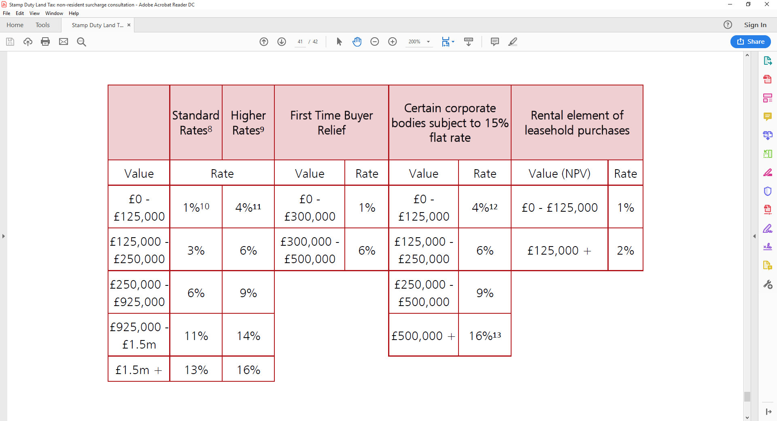
Non-UK resident surcharge
Feb 2019 Condoc – consultation closes 6 May
To add 1% on top of existing rates for residential properties
Proposed SDLT rates for non-UK residents
1
2
These rates will also apply to the premium element of leasehold transactions.
The higher rates will apply to purchases of additional dwellings and purchases of dwellings by persons other than an individual
Where the value of the dwelling is below £40,000, no SDLT will be due.
Ibid.
Ibid.
Where the value of a dwelling exceeds £500,000, a 16% rate will supersede the application of preceding rates and be applicable to the entire chargeable consideration. Where the corporate body is eligible for relief from the 15% rate, the higher rates will apply.
3
4
5
6
© Patrick Cannon

Slide 14
Non-UK resident surcharge
Individuals with fewer than 183 days in the UK in the 12 months ending with date of purchase will be liable
Refund claim available if they then spend 183 days in the UK in the following 12 months
Separate residence tests for companies, trusts and other buyers
Major blind spot: where non-UK resident off-plan buyer flips to a UK resident no surcharge will be payable because flipper gets relief from SDLT under either para 15, Sch 2A or para 12B, Sch 17A
© Patrick Cannon

Slide 15
Some Current SDLT Issues
Patrick Cannon
15 Old Square
clerks@15oldsquare.co.uk
www.patrickcannon.net
7 March 2019
© Patrick Cannon

